Slide 1
Ancient Egypt
Egyptian Society
Three Kingdoms
Religion

Slide 2
Egyptian Society
Nile River
  Cyclical
Social Organization
  Pharoah
  Priests and Nobles
  Peasants
  Slaves
    Gender Roles?

Slide 3
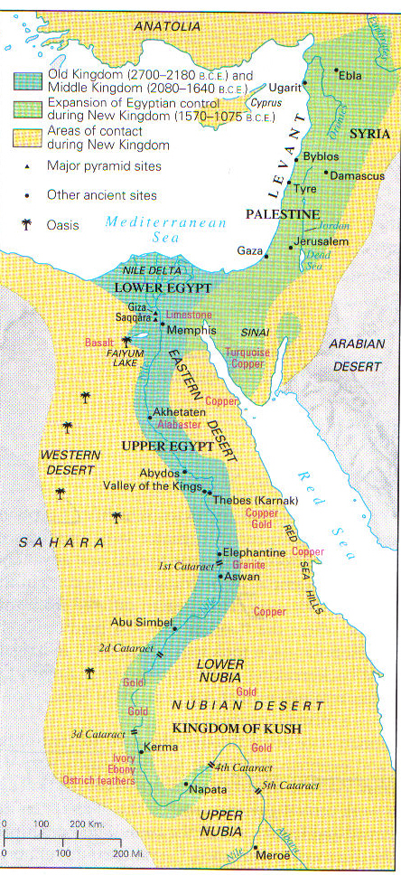

Slide 4
Three Kingdoms
Old Kingdom (2613-2160 B.C.E)
  Pharaoh
    Viziers
    Ma΄at
Middle Kingdom (2040-1750 B.C.E)
  Thebes
  Invention of Iron
New Kingdom (1550-1070 B.C.E.)
  Amenophis IV (r. 1353-1333)
    Aton
  Ramses II (r. 1290-1224)
    Amun-her-khepeshef vs. Moses

Slide 5
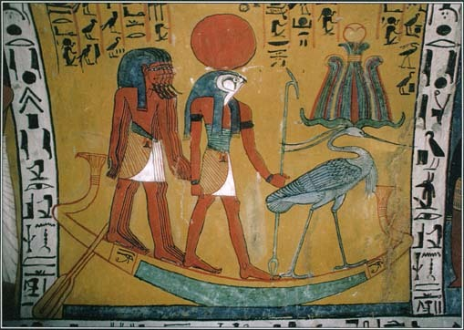
Ra (Re)

Slide 6
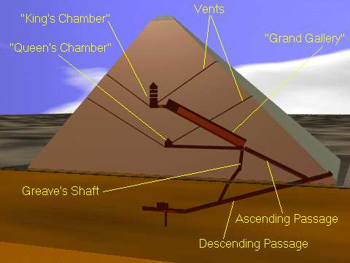
Pyramid of Khufu

Slide 7
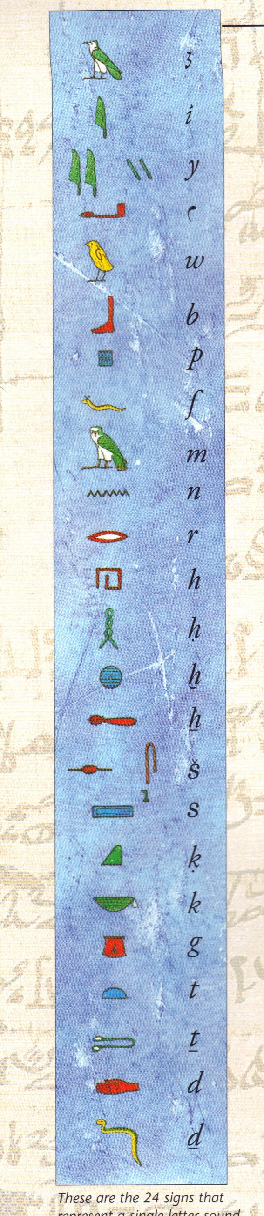
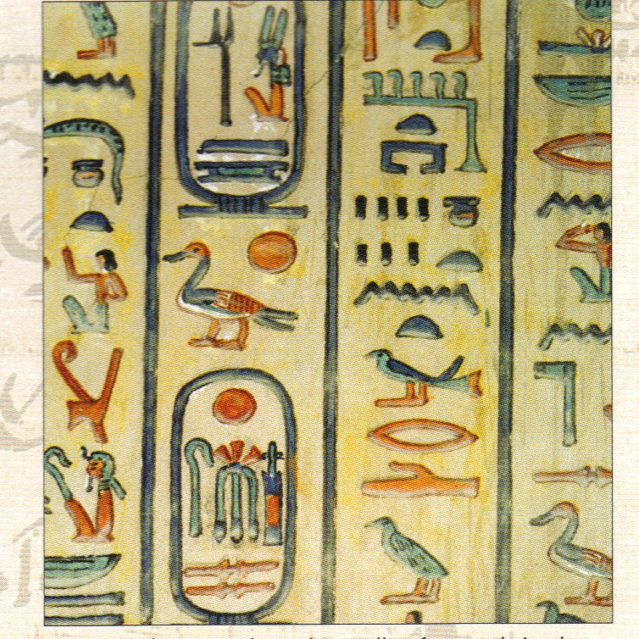
Hieroglyphs

Slide 8
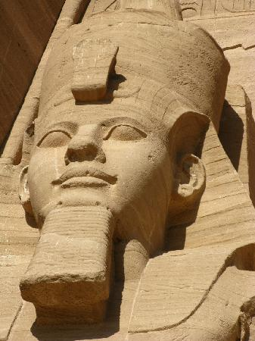
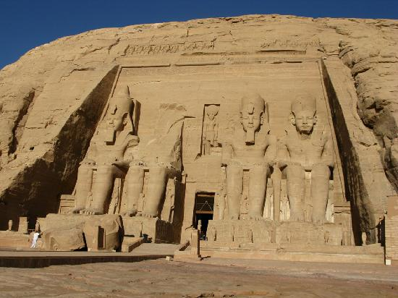
Pyramid of Ramses II

Slide 9
Religion
Preoccupation with the afterlife
  Mummification
Book of the Dead
  Anubis
    Ma΄at and judgement
  Osiris

Slide 10
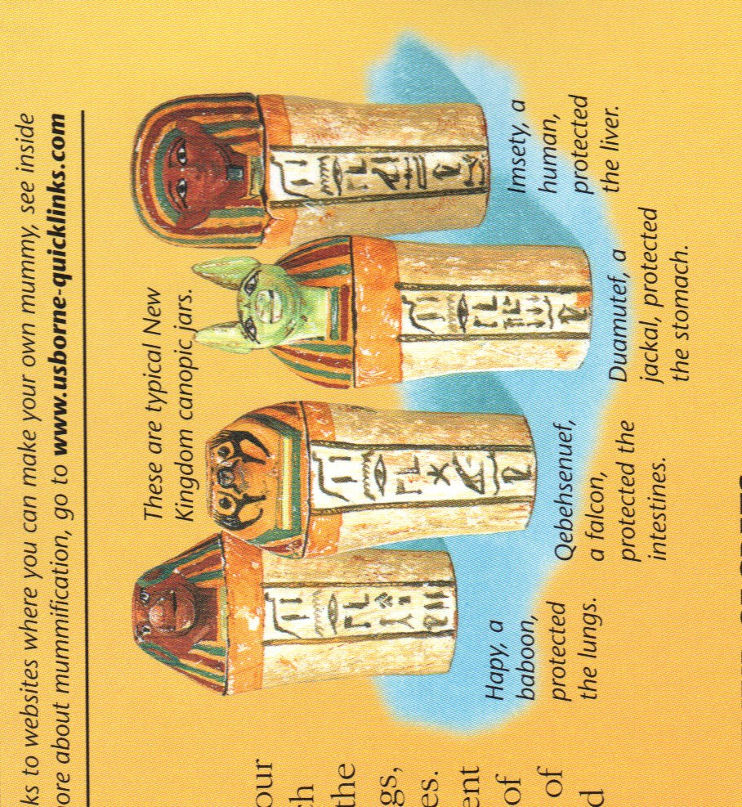
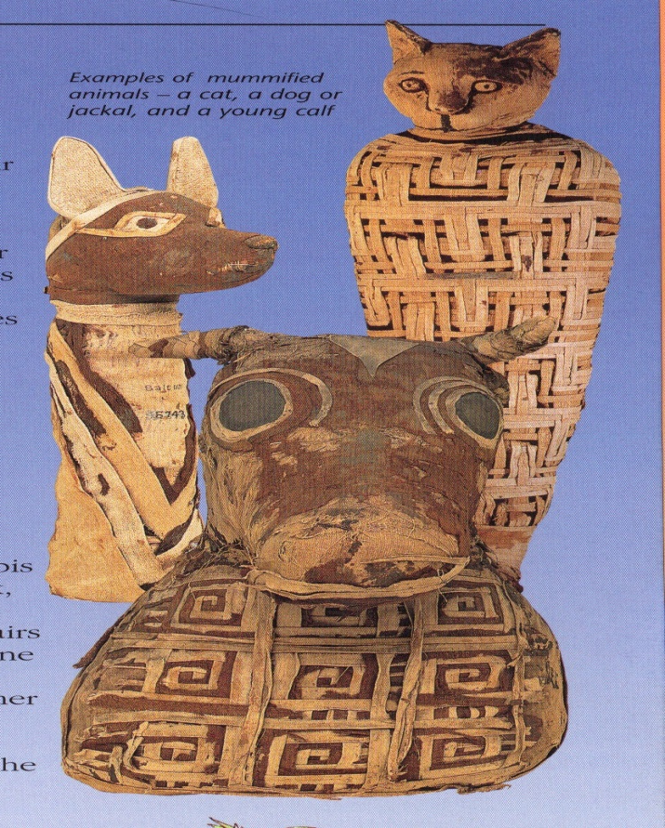
Mummification
Canopic jars
Mummified Animals

Slide 11
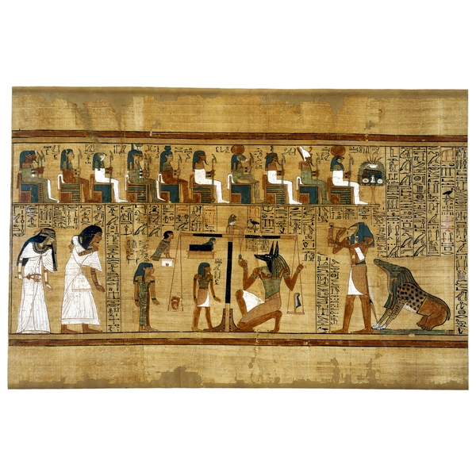
Papyrus: The Book of the Dead

Slide 12
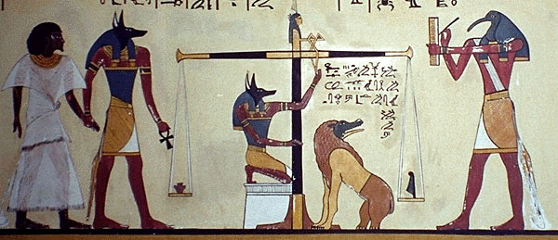
Anubis, Thoth, and Ammit

